Slide 1
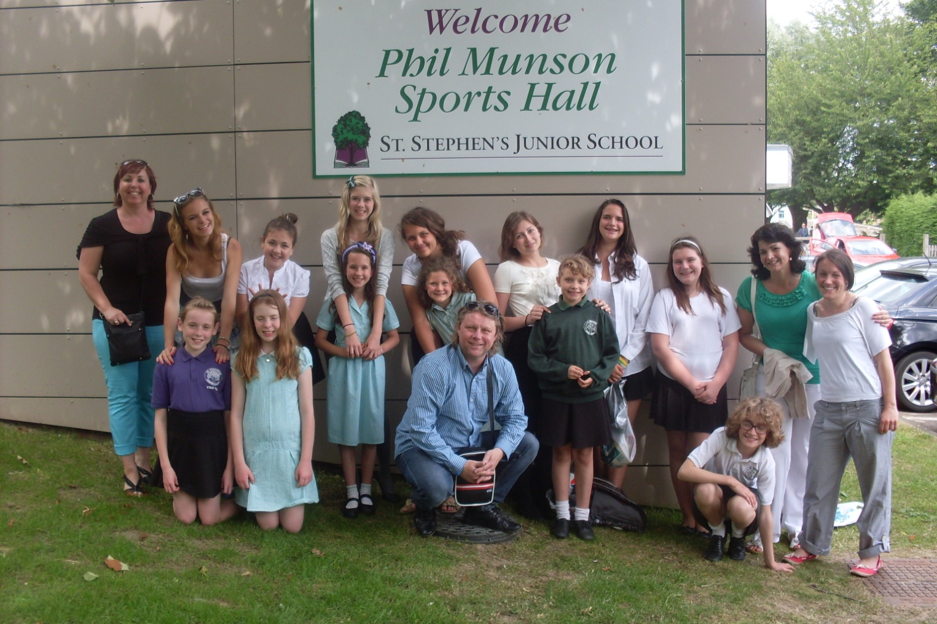
ARTISTS OF EUROPE
Canterbury
27.6. – 2.7. 2013
This project has been funded with support from the European Commission.
This publication [communication] reflects the views only of the author, and
the Commission cannot be held responsible for any use which may be made
of the information contained therein.

Slide 2
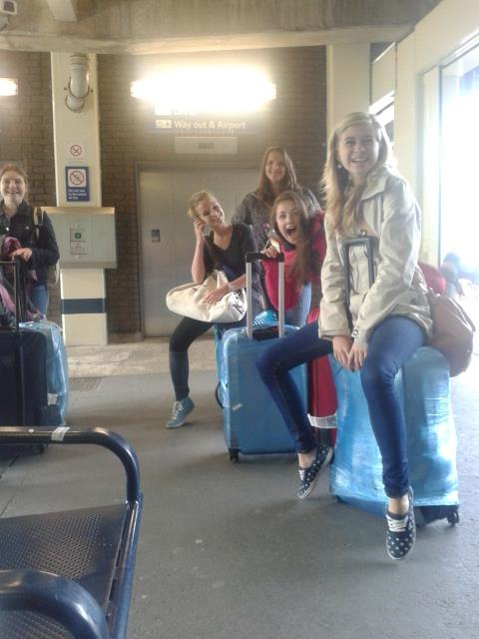
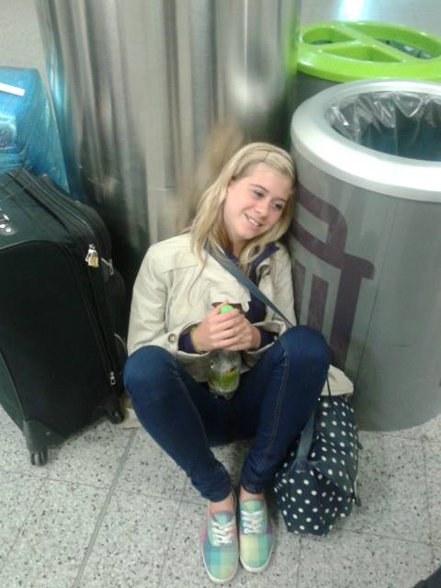
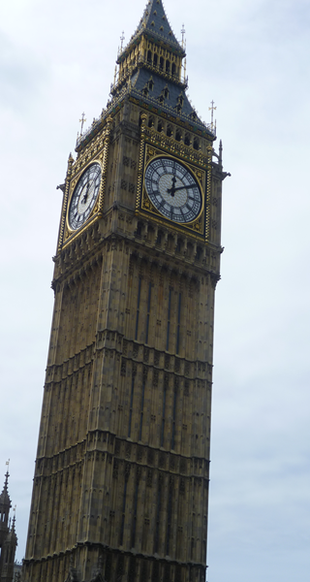
27th June - arrival We arrived at the airport in London and went by train to Canterbury. On the way we admired the beauty of England countryside and listened to English language and tried to speak it. We were welcomed at the station, picked to school and were accommodated at English families.
Notes:
We were welcomed at the station, picked to school and girls were accommodated by their English families.

Slide 3
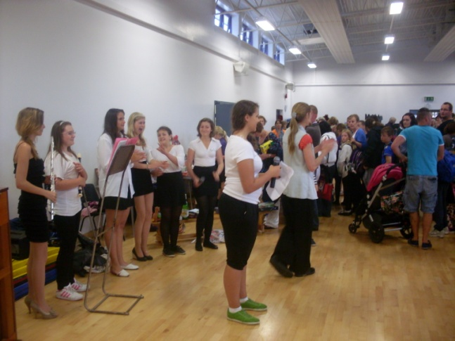
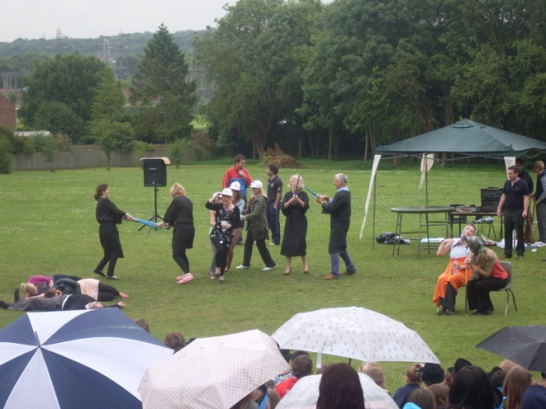
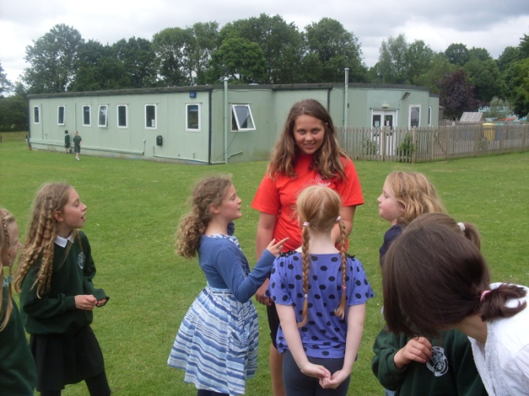
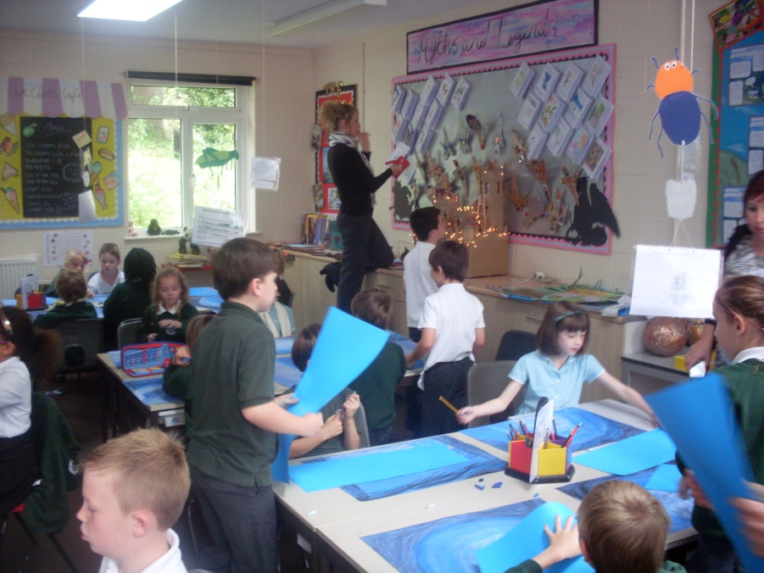
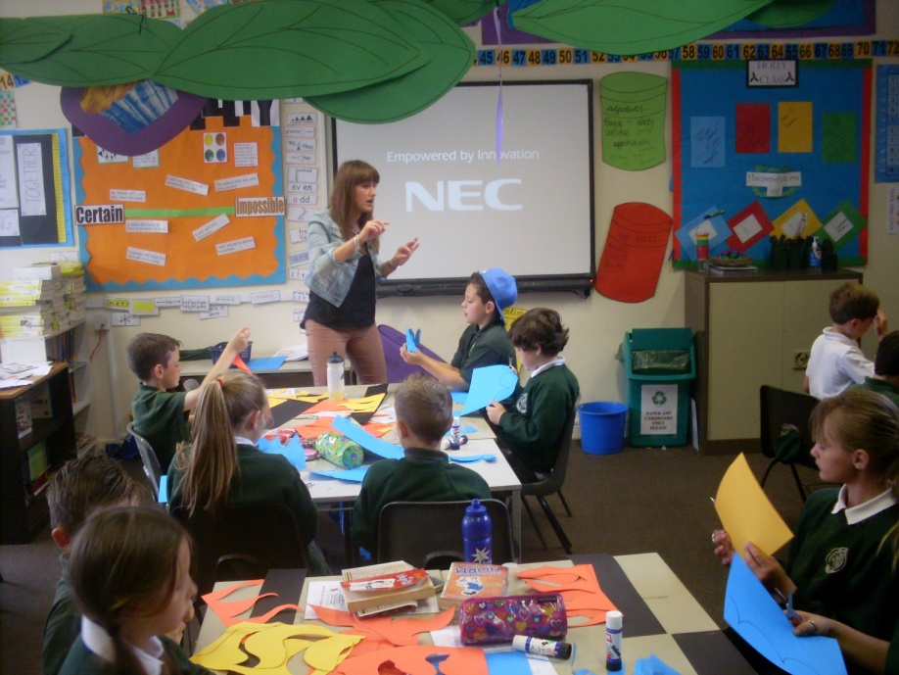
The FIRST day at the school – 28th June We spent this day at the school. We learned subjects in English and experienced the way of teaching. We liked it as well as the breaks outside. We admired the performance which was played by the teachers. We prepared the performance too. In the afternoon we enjoyed our stay with families.
Notes:
In the afternoon they enjoyed their stay with families.

Slide 4
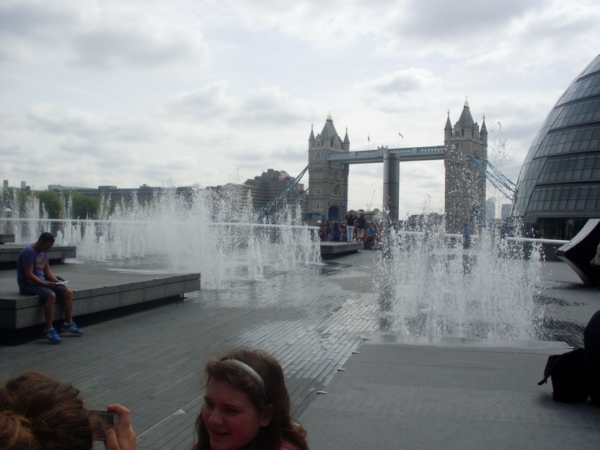
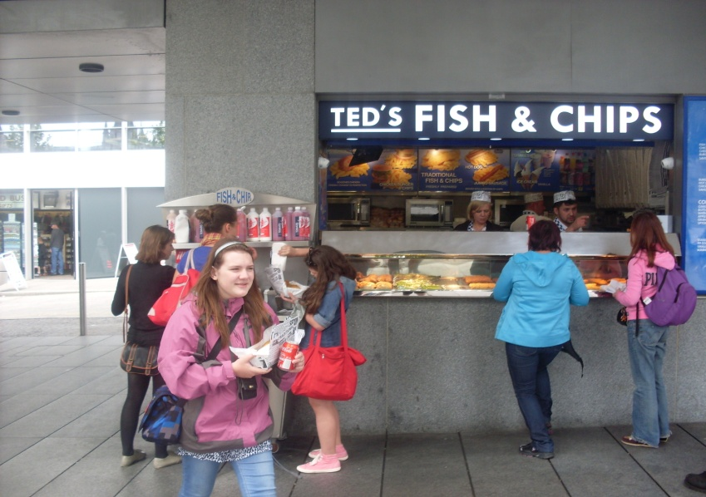
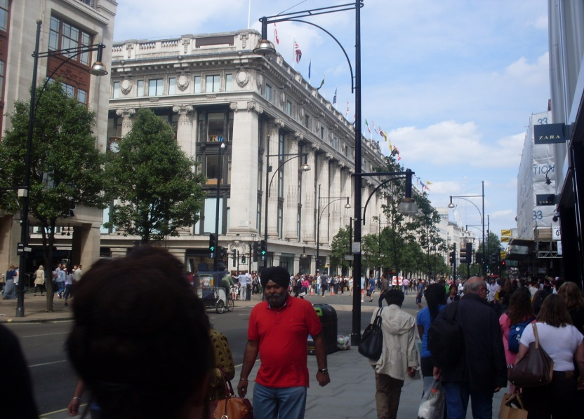
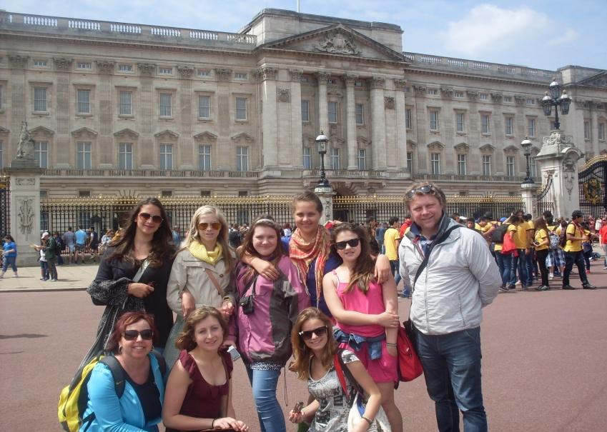
Trip to London – 29th June We took the train to London for a trip. We visited the London Bridge, the Tower, Buckingham Palace nad liked shopping in Oxford Street. The fast food „ fish and chips“ was really delicious.
Notes:
We took the train to London for a trip. We visited the London Bridge, the Tower, Buckingham Palace nad liked shopping in Oxford Street. The fish and chips was really delicious.

Slide 5
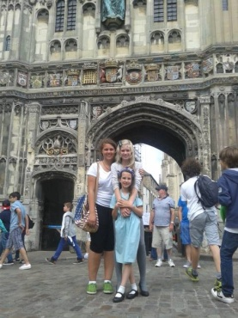
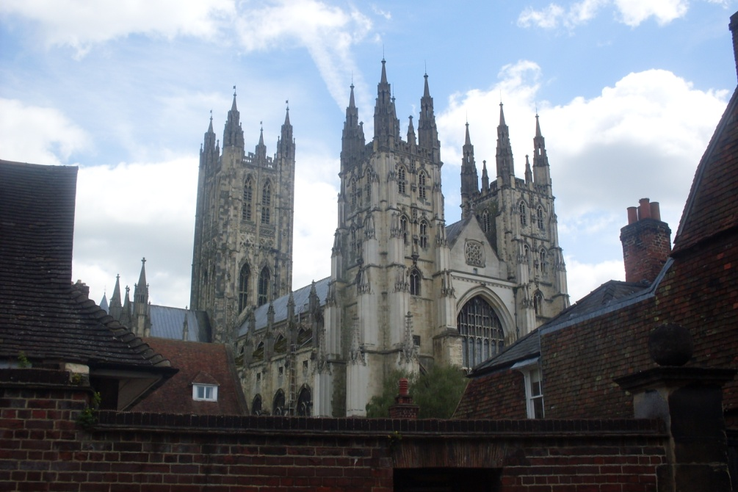
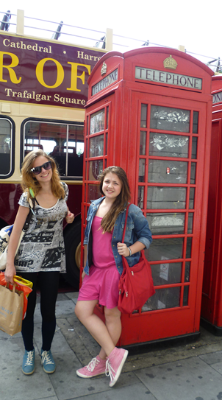
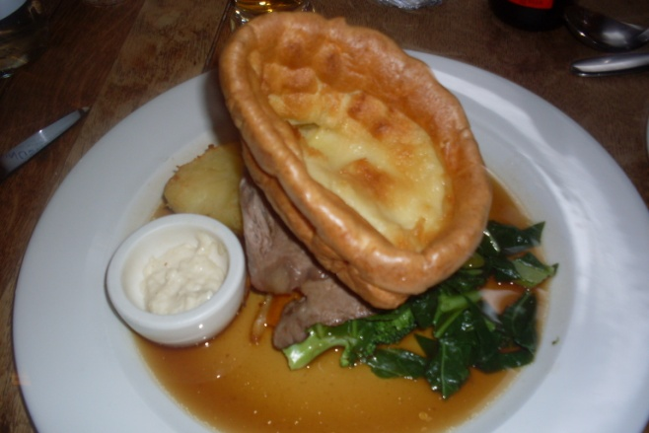
The Day with Family – 30th June We spent the day with our family. Most of us visited Cantebury and some went to the coast or to the country. We enjoyed it very much as well as the English festive cuisine.

Slide 6
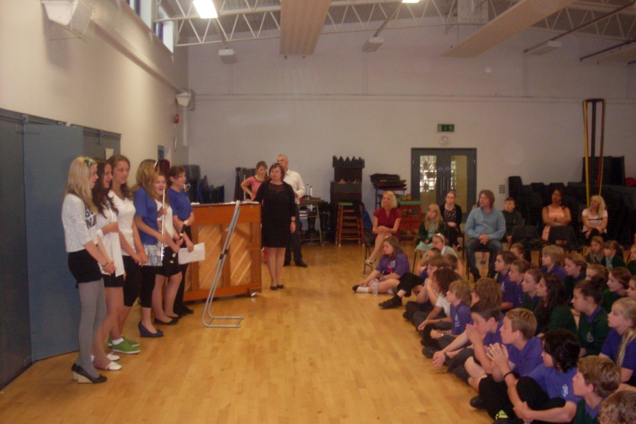
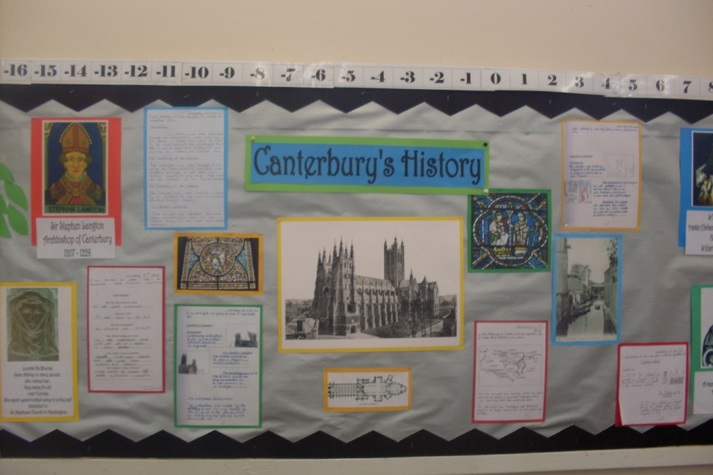
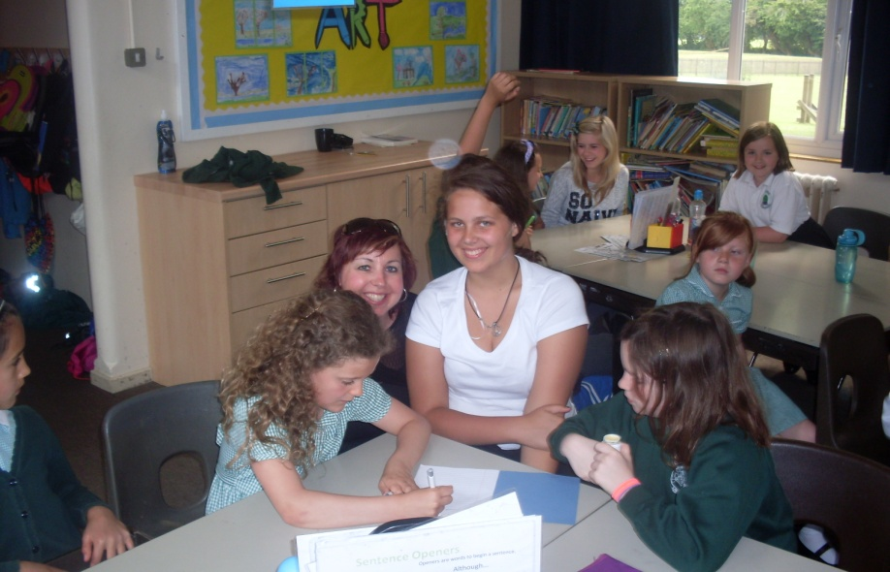
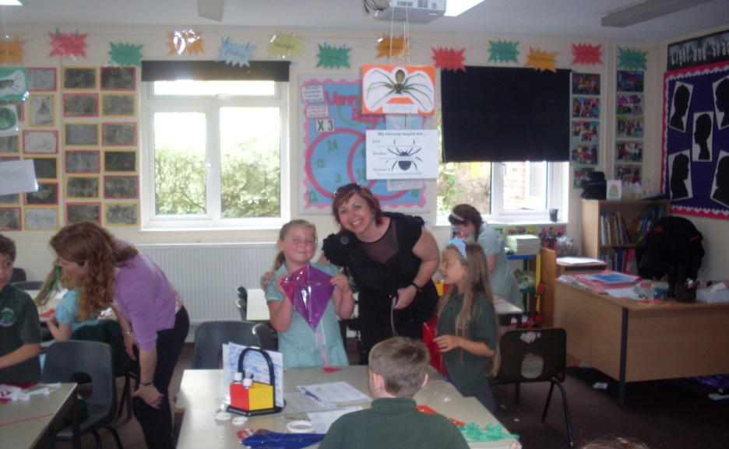
The second day at the school – 1st July The next day at the school was very inspiring. The school assembly at the gym was really perfect. Both English and Czech pupils acted performance and were successful. The lessons were interesting and the teachers very nice. The next day we left back home full of beautiful experience.

